Slide 1
Object Oriented Design and Analysis
Presented By:
Msc.CSIT 1st Semester (Group A)
Rajesh Acharya, Krishna Prasad Acharya, Anita Joshi,
Rahul Paudel, Rajesh Shahi, Shailesh Acharya

Slide 2
Outline
Introduction
Object Oriented method
Types of Object Oriented Method
Object Oriented Analysis(OOA/ Coad-Yourdon)
Object Oriented Analysis Method
Object Oriented Analysis Deliverables
Object Oriented Design(OOD/Booch)
The Concept of OOD Related To OOSE
Object Oriented Design Deliverables
Documentation Aspect Of OOD
Advantage/Disadvantage of OOAD

Slide 3
Introduction
The concept of Object-Oriented Analysis and Design (OOAD) originated in the late 1960s and early 1970s as a response to the increasing complexity of software systems.
Object-Oriented Analysis and Design (OOAD) is a software engineering methodology that involves using object-oriented concepts to design and implement software systems
OOAD involves a number of techniques and practices, including object-oriented programming, design patterns, UML diagrams, and use cases
OOAD is used in software development to create modular, maintainable, flexible, and scalable systems, improve productivity, enhance code reusability, and facilitate team collaboration.

Slide 4
Introduction cont..
All of the models aim at modeling system in terms of objects which will form the basis of system realization.
The central problem in all object modeling technique is to find an appropriate object structure.
There are some fundamental difference between OOSE and object oriented methods, some of these are-
Working with different object types in analysis model
The formalization of models
The need for the use case concept
The difference between process and methods
The degree of formalization

Slide 5
Object oriented Method
The term Object means a combination of data and logic that represents some real world entity.
When developing an object – oriented application, two basic questions always arise:
What objects does the application need?
What functionality should those objects have?
Some of the key object-oriented concepts in OOAD include
Object
Class
Inheritance
Encapsulation
Polymorphism
Abstraction
Association
Generalization

Slide 6
Types of object oriented methods
Object Oriented Design(booch method)
Object Oriented System Analysis (Shlaer and Mellor)
Object Modeling Technique (Rumbaugh)
Object Oriented Analysis (Peter Coad and Ed Yourdon)
Hierarchical Object Oriented Design
Object Oriented Structure Design (Wasserman et al.)
Responsibility Driven Design (Wirfs-Brock)
Object Oriented Role Analysis, Synthesis and Structuring [OORASS] (Reenskaug et al.)

Slide 7
Object Oriented Analysis (Coad-Yourdon)
Object–Oriented Analysis (OOA) is the procedure of identifying software engineering requirements and developing software specifications in terms of a software system’s object model, which comprises of interacting objects.
In OOA an analysis model is developed to describe the functionality of the system
The idea in the Coad-Yourdon design is to extend this model with respect to processes, human interface and DBMS issue.
The concept of OOA related to OOSE concepts
OOA
Class
Object
Class & object
Gen-Spec-Structure
Whole-part-structure
Instance connection
Message Connection
Attribute
Service
Subject
OOSE
Class
Instance
object
Inheritance
Consist-of
Acquaintance
Stimuli
Communication
Attribute
View, (subsystem)

Slide 8
Object Oriented Analysis Method
OOA uses basic structuring principles and join them with an object-oriented point of view.
The method consist of five steps; it is proposed that the following order should be adopted
Finding Class and Object
Identifying Structures
Defining Subjects
Defining Attribute
Defining Services

Slide 9
Object Oriented Analysis Deliverables
The model is presented and reviewed in a top-down manner in the following order
Subject layer
(only subjects are presented).
Class and Object Layer
(Class and object and subjects are shown).
Structure Layer
(Structures are added to the previous layer)
Attribute Layer
(Attribute are added to the previous layer)
Service Layer
(services are added to the previous layer)

Slide 10
Object Oriented Design(OOD/Booch)
object–Oriented Design (OOD) involves implementation of the conceptual model produced during object-oriented analysis. In OOD, concepts in the analysis model, which are technology−independent, are mapped onto implementing classes, constraints are identified and interfaces are designed, resulting in a model for the solution domain, i.e., a detailed description of how the system is to be built on concrete technologies.
The implementation details generally include −
Restructuring the class data (if necessary),
Implementation of methods, i.e., internal data structures and algorithms,
Implementation of control, and
Implementation of associations.
Grady Booch has defined object-oriented design as “a method of design encompassing the process of object-oriented decomposition and a notation for depicting both logical and physical as well as static and dynamic models of the system under design”.

Slide 11
Object Oriented Design(OOD/Booch) cont.….
The OOD/Booch method has great similarities to the OOA/Coad-Yourdon method in finding objects, the aim is to establish a grounding for implementation.
Booch focuses on the interfaces at various stages. He uses different kind of visibility of various grouping concepts.
The class category is a grouping of classes for presentation and abstraction purposes, very similar to the subjects in OOA

Slide 12
The concepts of OOD related to OOSE
OOD
OOSE
Class
Object
Uses instantiates
Inherits
Metaclass
Class category
Message
Field
Operations
Mechanism
Module
subsystem
Class
Instance/Object
(communication)
(communication)
Inheritance
(used by methodologists only)
Block
Stimuli
Attribute
Operation
(~Use case/ skeleton)
Block
Subsystem

Slide 13
Object Oriented Design Method
Booch strongly emphasizes the iterative process and the creativity of the developer as essential components in object oriented design.
The process of object-oriented design start with the discovery of the class and object that form the vocabulary of problem domain.
The process of OOD generally tracks the following order of events:
Identify classes and object at a given level of abstraction.
Identify the semantics of these classes and objects.
Identify the relationships among these classes and objects.
Implement these class and objects.

Slide 14
Object Oriented Design Deliverables
The major strength in OOD is perhaps the richness of the diagramming technique offered to the developer.
By viewing the model develop from different views, a rich set of perspectives is proposed that expresses different thing about the model
The logical view consist of the class structure and object structure
The physical view consist of the modules of the system
Booch uses two dynamic diagram
State transition diagram
Timing diagram

Slide 15
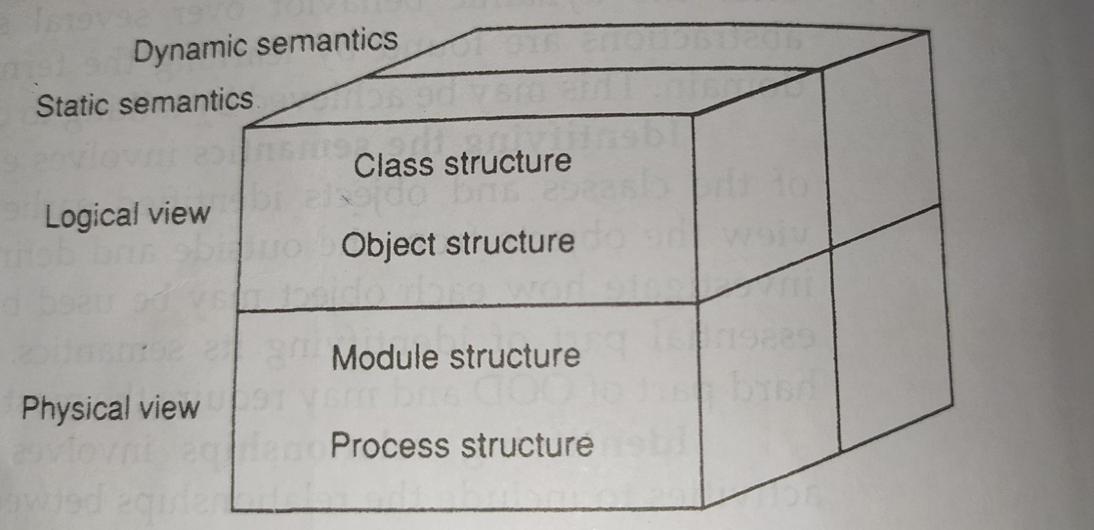
Documentation aspect of OOD
Fig- Documentation aspect of OOD

Slide 16
Advantage of Object Oriented Analysis And Design
Improved Modularity
Better Abstraction
Improved Reuse
Scalability
Maintainability
Flexibility
Improved software quality
Improved Communication

Slide 17
Disadvantage of Object Oriented Analysis And Design
Complexity
Overhead
Steep learning curve –(concept of OOP needed)
Time consuming
Rigidity
Cost

Slide 18
Thank You…….

